Slide 1
Black Individuals Achieving Success

Slide 2
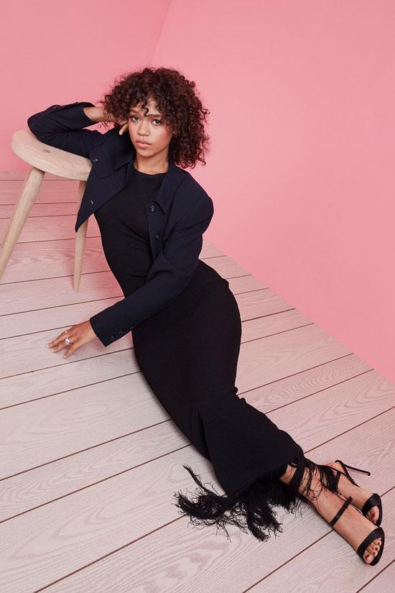
Actor Taylor Russell is quickly becoming one to watch. Born in Vancouver, the 25-year-old had a huge year in 2019, with roles in the acclaimed family drama Waves, horror film Escape Room and the Netflix sci-fi show Lost in Space. Her portrayal of sensitive and complicated Emily in Waves was especially noteworthy; Russell told ELLE U.S. that she was immediately drawn to the role. “I know her, I know this girl,” she said. “From that point, I fought really hard to get it – I wanted it so badly.”
Taylor Russell

Slide 3
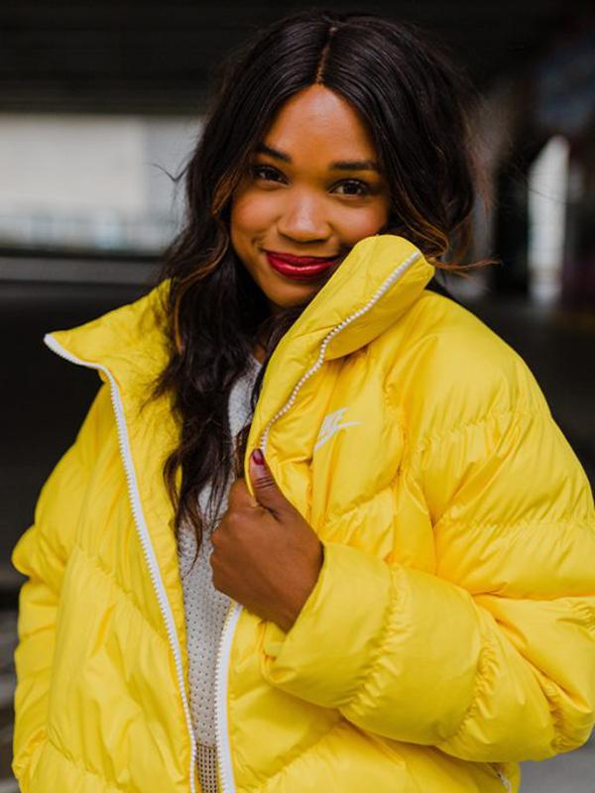
After graduating from the College of Sports Media in Toronto, Kayla Grey quickly climbed the ranks of the sports news world; she’s reported everywhere from Winnipeg to Prince Rupert and now you can catch her on TSN. She covered the Raptors’ historic NBA championship win last year and has incredible style. Safe to say, she’s a force.
Kayla Grey

Slide 4
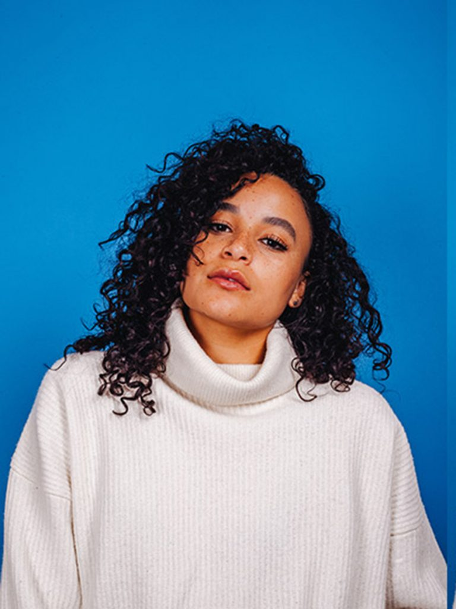
Karena Evans might not be a household name just yet, but you’ve definitely seen the 24-year-old actor and director’s work before. She has joined forces with fellow Torontonian Drake (heard of him?) on his music videos for songs like “God’s Plan” and “Nice for What” along with directing videos for SZA and Coldplay. Evans also starred in Firecrackers, which premiered at TIFF in 2018 – she told ELLE Canada that acting and directing are equally important to her: “I started doing both before I even knew I could push forward and make a life out of it…. Both things are storytelling, just with different energies.” As the first woman to win the Prism Prize Lipsett Award, it’s clear she will continue to push boundaries.
Karena
Evans

Slide 5
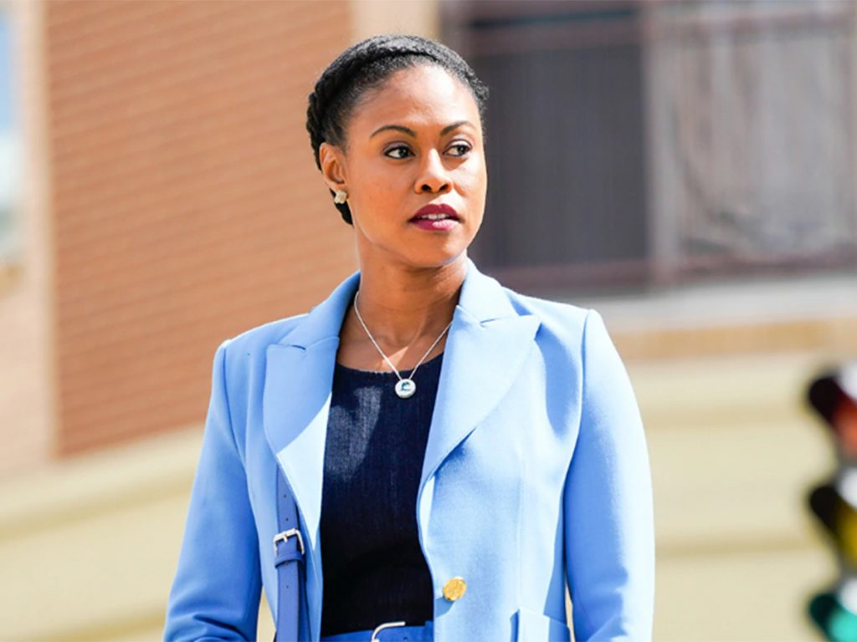
Vinessa Antoine
Last year, Toronto-born actor Vinessa Antoine made television history as the first Black Canadian woman to star in an hour-long Canadian series. While that title is long overdue, Antoine continues to lead the CBC series into its second season, premiering March 4. “It feels great to be the first, but it also gives me pause and question a lot of things,” Antoine told us in 2019. “Growing up, I didn’t see a lot of me reflected on TV; I didn’t see the world I lived in. It’s about time. Hopefully this is the beginning of a bigger change.

Slide 6
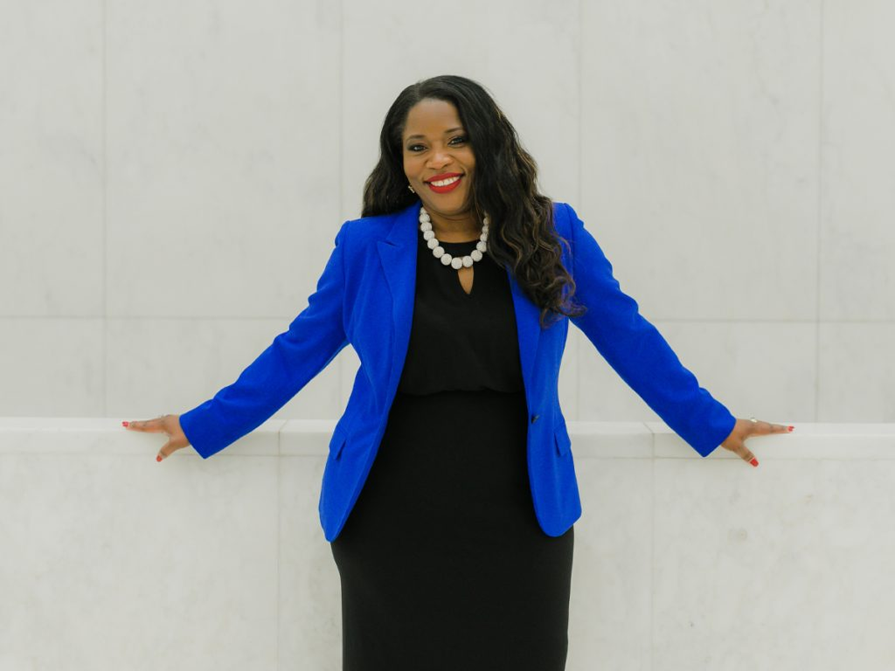
Claudette McGowan
Claudette McGowan gives the stereotypical bank executive in a suit a run for their money (pun intended). As the Chief Information Officer at the Bank of Montreal, McGowan is a powerful leader in information technology. Her CV is just as impressive as you might think: Before starting at BMO in 2000 she worked at Deloitte, Metropolitan Police Services and North York General Hospital. She is the recipient of many accolades, such as WXN Canada’s Most Powerful Women: Top 100 Award and has interviewed Michelle Obama. And she writes children’s books in her spare time

Slide 7
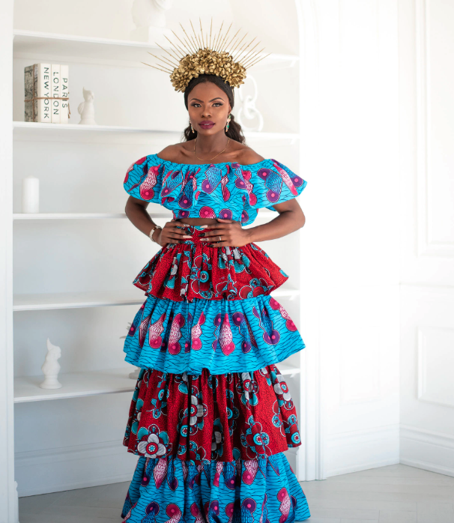
You might think that going from the health sector to fashion wouldn’t be an easy transition, but Catherine Addai, creator and designer of Toronto-based label Kaela Kay, isn’t one to follow the rules. She quit her corporate career a few years ago and taught herself how to design clothes, creating the label’s signature style with bright patterned garments influenced by her Ghanian roots. It’s no wonder that celebrities are beginning to flock to her unique designs: Ava DuVernay and Busy Philipps have both rocked Kaela Kay pieces
Catherine
Addai

Slide 8
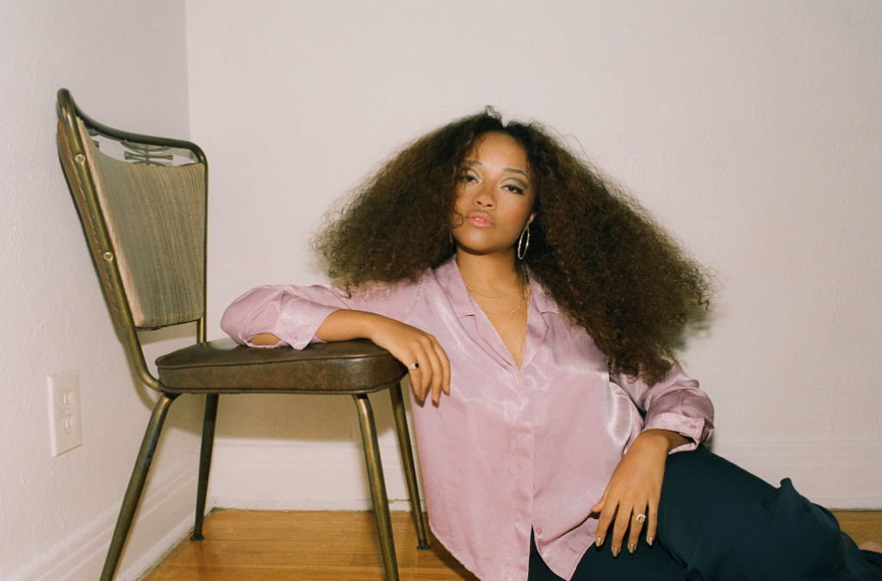
Shay Lia’s music is as eclectic as her upbringing. The Montreal-based singer-songwriter fuses her French and East African (she moved to Djibouti from France when she was four, departing for Canada at 18, according to an interview with Wonderland) influences to make fresh and modern R&B tracks. Her breakthrough was the hit 2014 track “Leave Me Alone,” a collab with fellow Montrealer Kaytranada. She released her debut EP, Dangerous, last year, and with a recent European tour under her belt, the gospel according to Shay Lia is sure to be spreading
Shay Lia

Slide 9
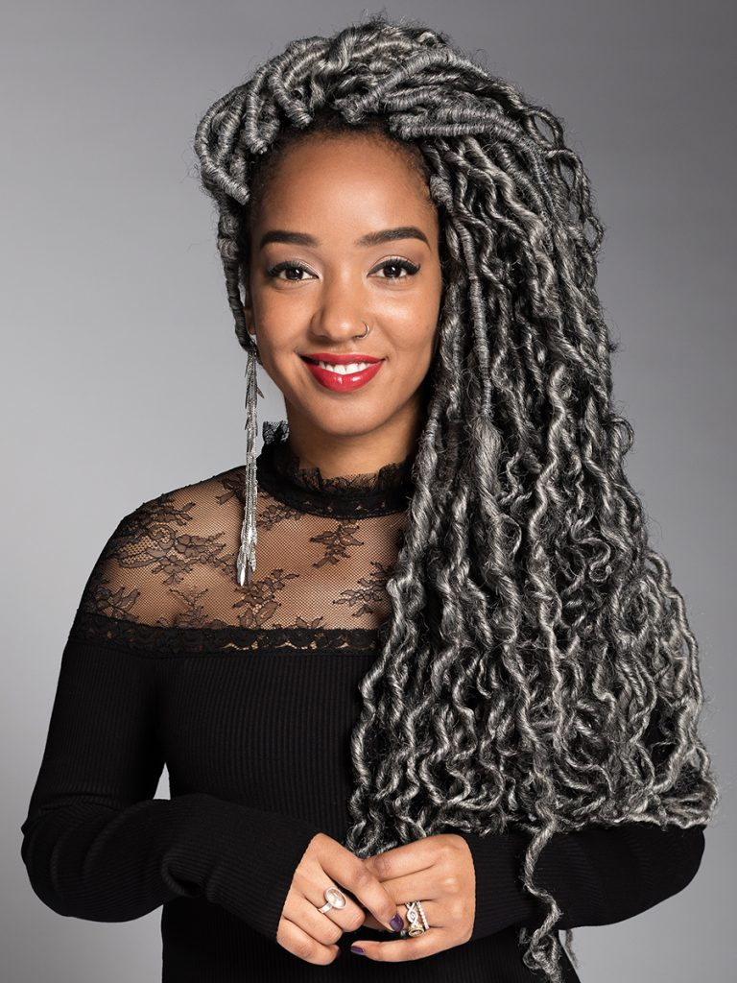
You’ve probably heard of (or simply heard) CBC’s Amanda Parris before. She writes a weekly column for CBC Arts, hosts three (!!) TV series on CBC (CBC Arts: Exhibitionists, The Filmmakers and From the Vaults) and hosts the radio program Marvin’s Room. On top of the many hats she wears, she’s also a play- and screenwriter at night. Impressed yet? There’s more: Her most recent play, Other Side of the Game, received the 2019 Governor General’s Award for drama.
Amanda
Parris

Slide 10
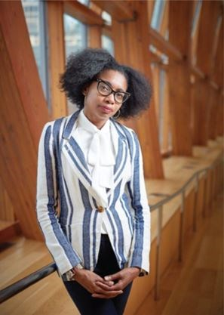
As assistant curator for photography at the Art Gallery of Ontario, Julie Crooks has made big progress in making the gallery’s collections more inclusive. Just last year, she was largely responsible for acquiring The Montgomery Collection of Caribbean Photographs – 3,500 historic Caribbean photographs from 34 countries including Jamaica, Barbados and Trinidad. Before working at the AGO, Crooks curated and co-curated several other exhibits, such as No Justice, No Peace: From Ferguson to Toronto (2017) and the Of Africa project at the Royal Ontario Museum.
Julie Crooks

Slide 11
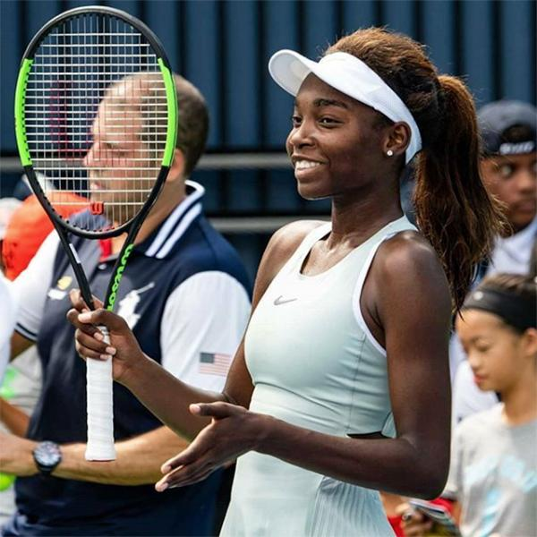
Montreal-born Françoise Abanda is a tennis superstar. She started playing when she was just seven years old and has quickly climbed the professional ranks, achieving a career-high junior rank of fourth in 2013. She told Global News in 2018 that she has faced racism in the tennis world in the past, but she maintained a positive and hopeful outlook that things can change. “Beyond tennis, we’re all human and we should all treat each other with respect, first of all, before even playing tennis.”
Françoise
Abanda

Slide 12
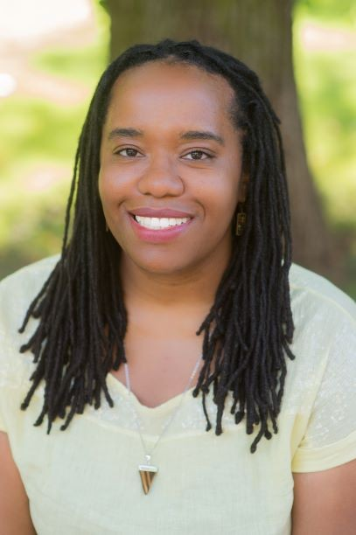
When it comes to the history of Black beauty in Canada, Cheryl Thompson is an expert. The Ryerson University professor turned her academic dissertation into a book called Beauty in a Box: Detangling the Roots of Canada’s Black Beauty Culture. The book focuses on Black women’s hair and how it intersects with Canadian immigration, politics and society. Thompson explained her reasoning behind her important research to NOW Magazine: “In Canada, [we] don’t tend to think of Black communities as being proactive. There tends to be a narrative that things just happen to us. The reality is all of those African-Americans selling products wouldn’t have been able to come to Canada if the infrastructure didn’t exist.”
Cheryl Thompson

Slide 13
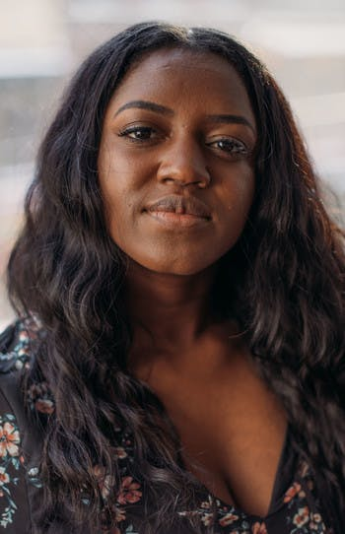
According to an interview with PRISM Magazine, writer and Scarborough native Téa Mutonji wrote her debut short story collection, Shut Up You’re Pretty, while listening to SZA’s Control. The accompaniment makes sense: Shut Up You’re Pretty is a coming-of-age book, specifically written through the lens of a young Black woman (much like the format of SZA’s album). The book has been lauded for its detailing of young Congolese women’s experiences growing up in a society that favours sameness.
Téa Mutonji

Slide 14
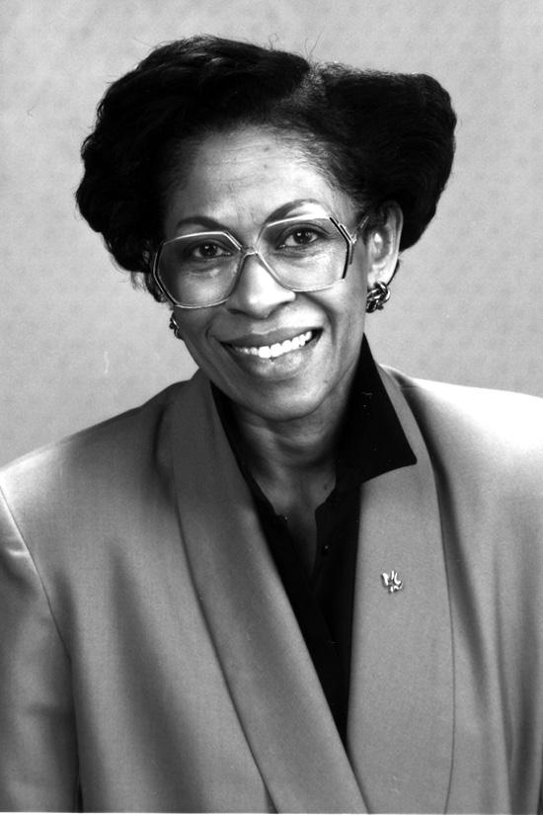
“This time, we’ll leave no woman behind,” activist and former politician Zanana Akande said at the 2018 Toronto Women’s March. Akande has dedicated her life to social issues. She was the first black woman to be elected to the Legislative Assembly of Ontario in 1990. After leaving politics in 1994, she stayed committed to working with many community-based groups, like the Urban Alliance on Race Relations. As seen at the Women’s March, Akande can still be found using her voice for activism; she’s currently working as the chair of the non-profit Black Legal Action Centre.
Zanana Akande

Slide 15
For years, Traci Melchor has been bringing her vibrant personality and intelligent reporting to our TV screens. Born in Pickering, Ont., the Etalk correspondent got her start as the host of MuchMusic’s RapCity. Throughout her career, Melchor has covered countless red carpets and conducted insightful interviews with hundreds of stars, including Beyoncé, Oprah and Mariah Carey. Melchor helped launch The Social as a co-host, but left the show in 2016 to take care of her mental health. Today, aside from her duties at Etalk, she inspires by supporting a number of charities and talking openly about the importance of self-care.
Traci Melchor

Slide 16
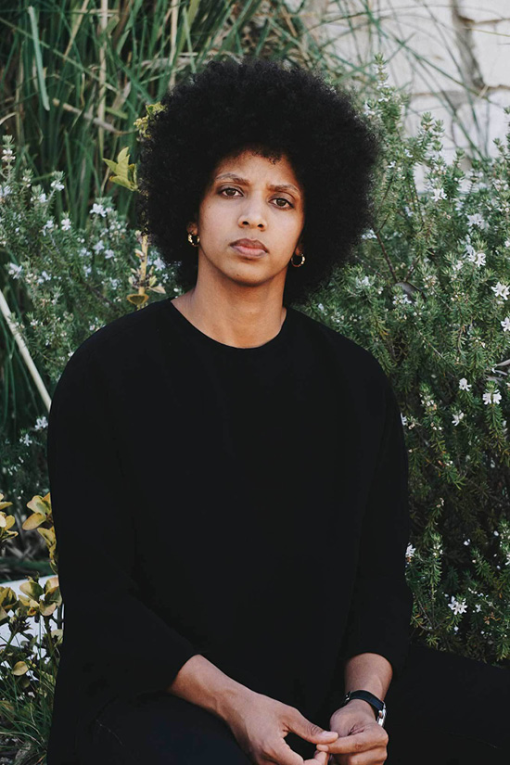
In 2014, Janaya Khan co-founded Black Lives Matter Canada after the death of Jermaine Carby, who was fatally shot by a police officer in Brampton, Ont. (The police officer was not charged.) Currently based in Los Angeles, Khan continues to fight for the justice and equality of people of colour and the LGBTQ community.
Janaya Khan

Slide 17
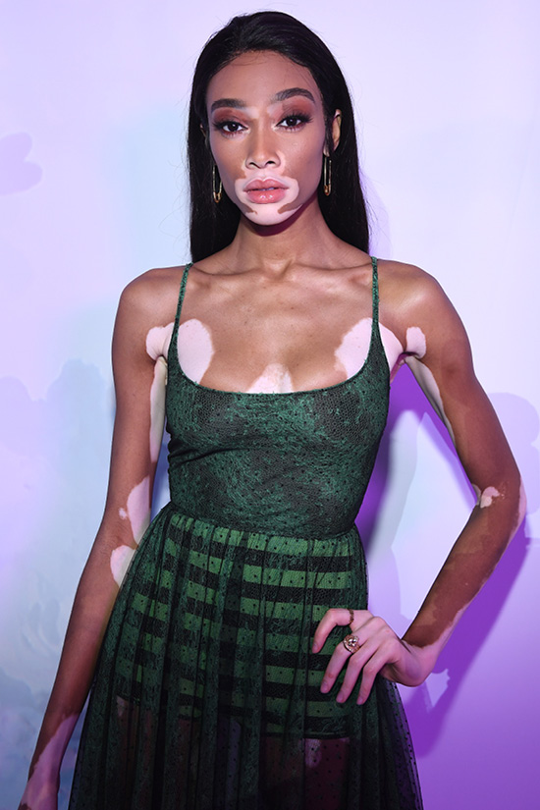
Not many people can say they’ve given a TEDx talk, been name-checked in a Drake song and appeared in a Beyoncé video, but not many people are Winnie Harlow. The 25-year-old was discovered by Tyra Banks on Instagram and made her international modelling debut on America’s Next Top Model in 2014. While the GTA-born model didn’t win the cycle, she began appearing in campaigns, fashion weeks and magazines (including gracing the cover of our September 2019 issue).
Winnie
Harlow

Slide 18
In 1992, Lana Ogilvie became the first black model to sign a contract with CoverGirl. After being scouted at her high-school fashion show in Toronto, she moved to New York and signed with Ford Modeling Agency, walking in shows for high-profile designers like Azzedine Alaïa, Sonia Rykiel and Karl Lagerfeld. In the ’90s, Ogilvie became an advocate for more inclusive representation within the fashion industry.
Lana
Ogilvie

Slide 19
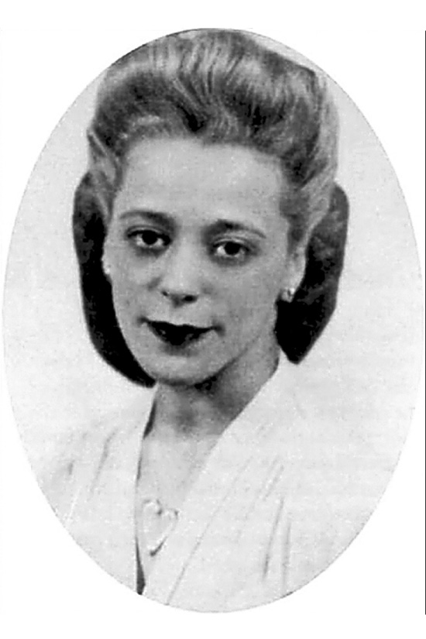
After Halifax-born entrepreneur Viola Desmond found success in running her own hair salon, the trained beautician opened a beauty school, where she was a mentor to many Black Canadian women. But across the country, Desmond is remembered for bravely challenging segregation: While at a movie theatre in 1946 in New Glasgow, N.S., she was forcibly removed after sitting on the ground floor — the whites-only section. Although Desmond offered to pay the one-cent difference in tax, she was still arrested and sentenced to 30 days in jail and charged a $26 fine. In 2010, the province of Nova Scotia apologized to and pardoned Desmond, who died in New York in 1965. In 2018, she became the first Canadian woman to appear on the face of a Canadian banknote.
Viola Desmond

Slide 20
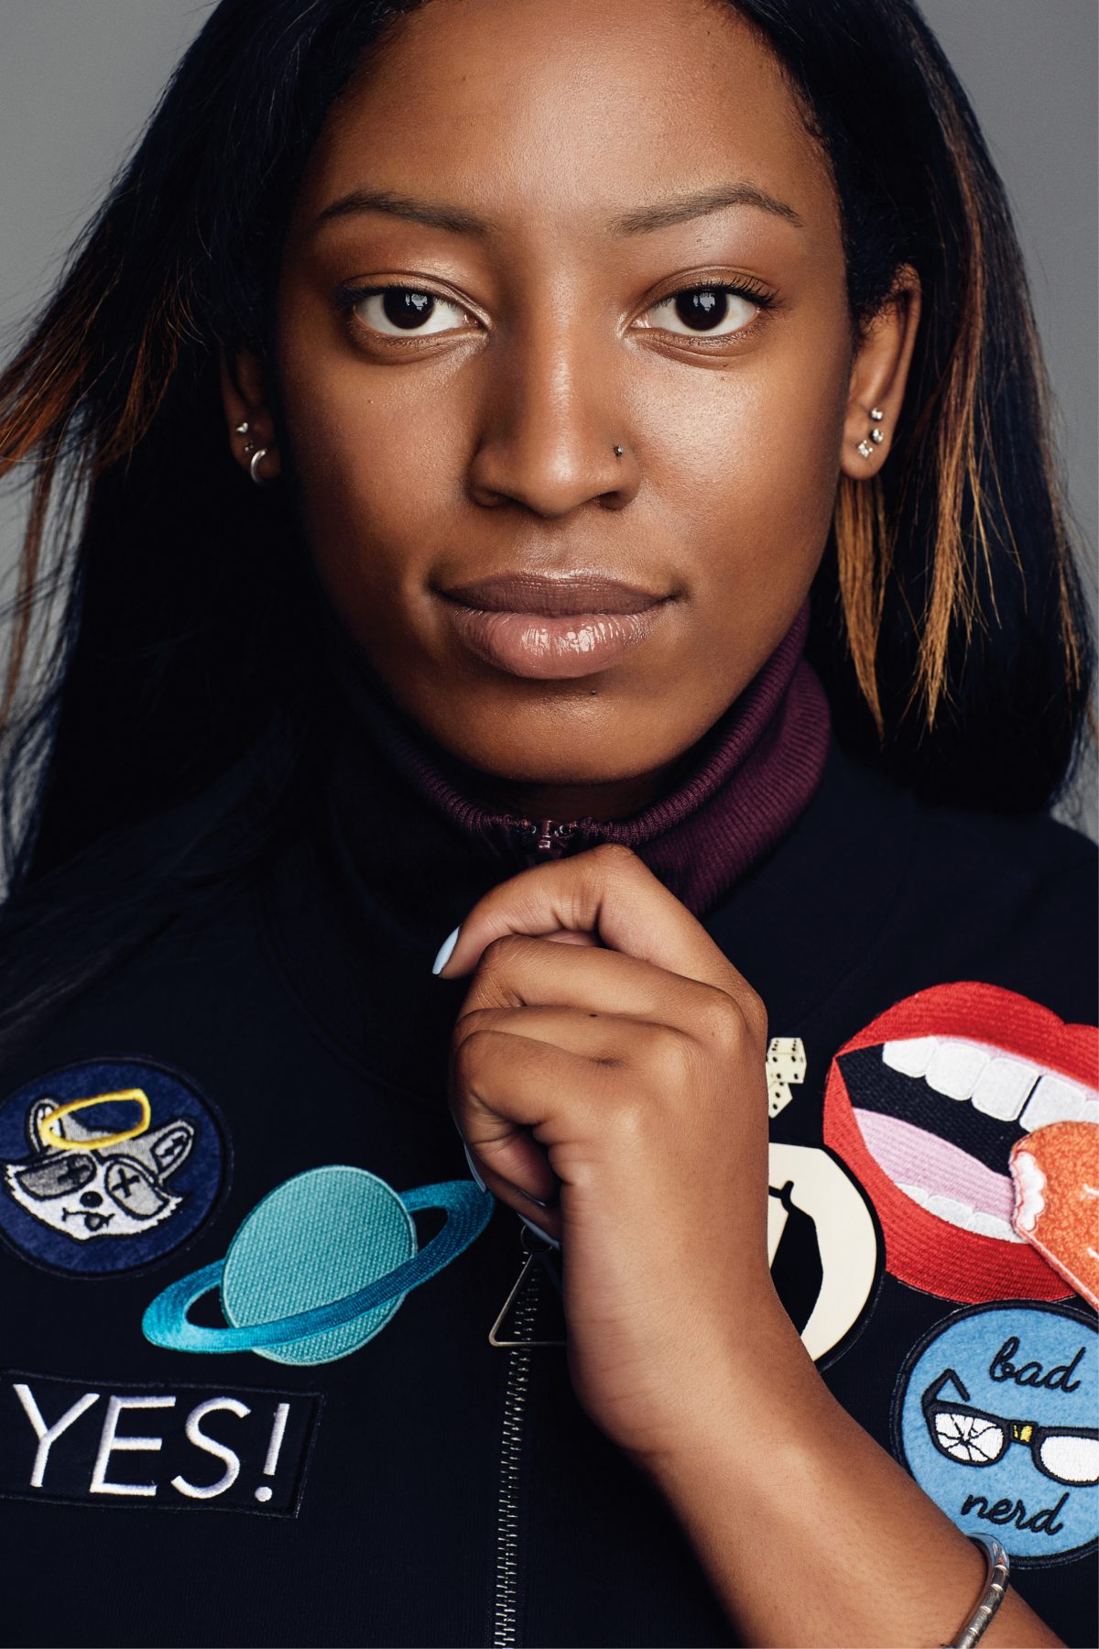
Brampton-born producer WondaGurl (née Ebony Oshunrinde) got her big break at the ripe old age of 16 when a track sent to Travis Scott, an American rapper, ended up in the hands of rap legend Jay-Z. “It was weird,” she said in an interview for our March 2016 cover. “It didn’t feel like my beat anymore because you never imagine Jay-Z using your stuff—especially at 16.” She went on to produce two songs for Drake’s 2015 album If You’re Reading This It’s Too Late and worked with Rihanna and Big Sean. The now 23-year-old is still producing and working toward the ultimate goal: working with Kanye West.
Wondagurl

Slide 21
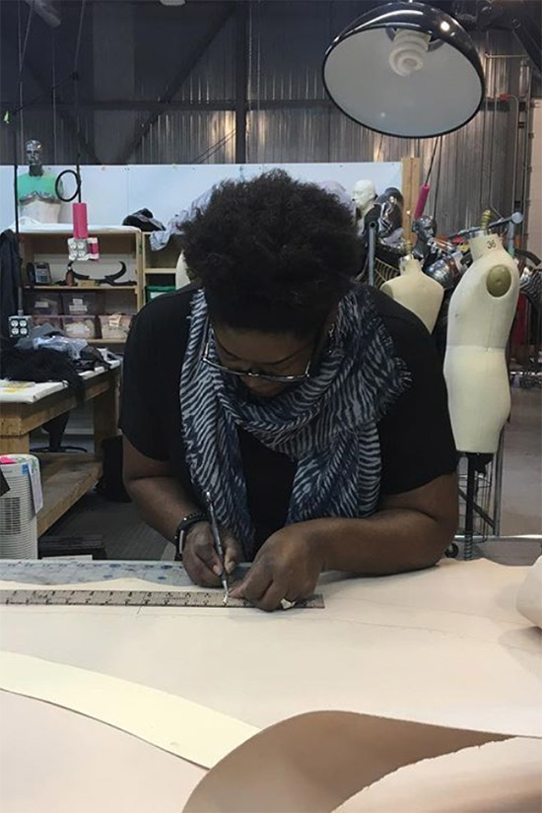
Since the ’90s, Gersha Phillips has worked as a costume designer for both film and television. Although she studied fashion and costume design in school, it wasn’t until she saw the opening credits of the film Beaches that she decided to pursue costume design as a career. The Toronto-based costume designer has worked on the sets of several films, like Walking Tall, My Big Fat Greek Wedding 2 and The Mortal Instruments: City of Bones, for which she was nominated for a Canadian Screen Award for Best Achievement in Costume Design. Recently, Phillips worked on the set of Star Trek: Discovery and was nominated for a Costume Designers Guild Award for Excellence in Sci-fi/Fantasy TV.
Gersha
Phillips

Slide 22
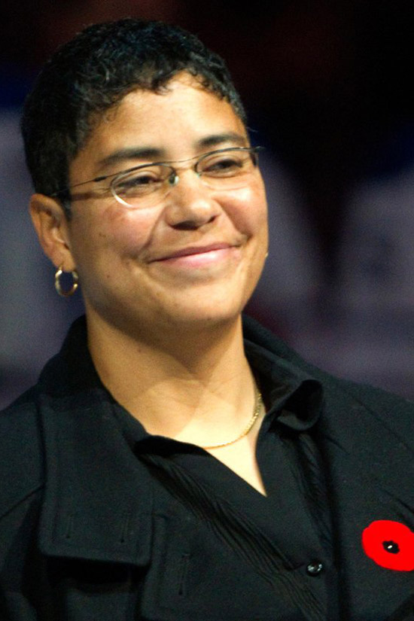
Angela James
You may better recognize women’s hockey pioneer Angela James by her nickname, the “Wayne Gretzky of women’s hockey.” James earned the moniker after scoring a stunning 50 goals and 73 points in just 14 games during a season at Seneca College. Despite missing the Olympics – she was controversially cut from the first women’s team in 1998 – James still made an international mark during her career, helping lead Canada to gold four times at the Women’s World Championship. James retired from play in 2000 and moved on to coaching. In 2010, James became one of the first two women, the first openly gay player and only the second Black athlete ever to be inducted into the Hockey Hall of Fame.

Slide 23
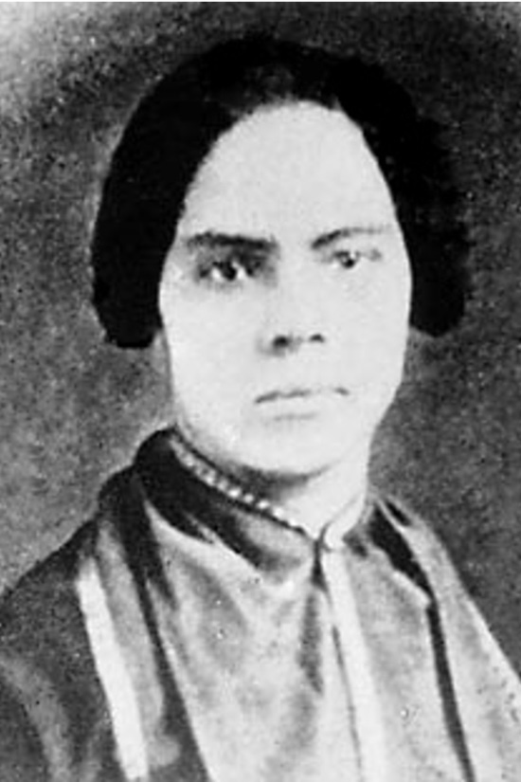
Mary Ann Shadd was born in 1823 in the slave state of Delaware to “free” parents, whose home was a safehouse on the Underground Railroad. The eldest of 13 kids, Shadd eventually moved to Windsor and opened a racially integrated school. By 1853, she’d founded and edited the Provincial Freeman, a weekly newspaper that was anti-slavery and publicized the successes of Black people in Canada, making her the first woman to publish a newspaper in the country. Before her death in Washington, D.C., in 1893, she became one of the first Black women to earn a law degree. In 1994, she was honoured as a person of national historic significance in Canada.
Mary Ann Shadd

Slide 24
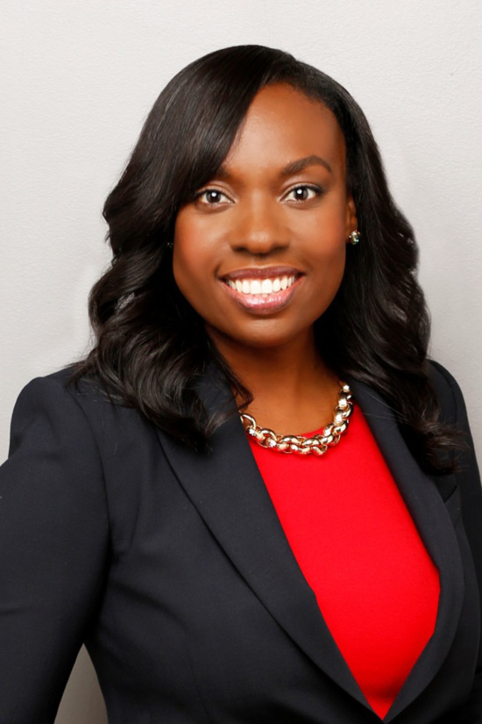
“By being an example, you have the ability to encourage other women to take risks, show initiative, and take on leadership roles,” Ontario MPP and Mitzie Hunter told us. And Hunter, who immigrated to Canada with her family from Jamaica when she was just four years old, definitely leads by example. Before becoming a politician, the U of T grad was the CEO of the Greater Toronto CivicAction Alliance, where she dedicated herself to social, economic and environmental issues. First elected to the Liberal government in 2013 (then re-elected in 2014 and 2018), Hunter also worked as the minister of advanced education and skills development, where she focused on issues like providing free post-secondary-school tuition to students in need.
Mitzie Hunter

Slide 25
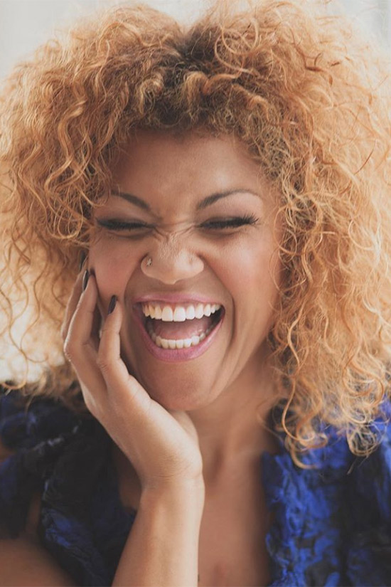
Measha Brueggergosman
Born in Fredericton, New Brunswick, Brueggergosman started singing at age seven. She went on to receive a B.A. in Music from the University of Toronto, and, in 1998, received the lead role in Beatrice Chancy, an opera about an enslaved African-Canadian woman in 19th-century Nova Scotia. Following the success of her debut role, the singer – who combined her and her husband’s last names to get Brueggergosman – has gone on to perform across Canada and the world. In 2005, she won the Juno Award for Classical Album of the Year: Vocal or Choral. She can be seen both on and off stage as a performer and music education advocate.

Slide 26
Jean Augustine is the reason Canadians celebrate Black History Month every February. Born in St. George’s, Grenada, Augustine immigrated to Canada in 1960 and went on to be the first black female member of Parliament. In 1995, August made a motion to recognize February as Black History Month, which passed unanimously, 305-0. As a result of her hard work and dedication to education and politics, she received the Queen’s Diamond Jubilee Medal in 2012, and was appointed to Commander of the Order of the British Empire in 2014. Augustine retired from politics in 2006 but continues to work as an advocate and community builder at the Jean Augustine Centre for Young Women’s Empowerment.
Jean Augustine

Slide 27
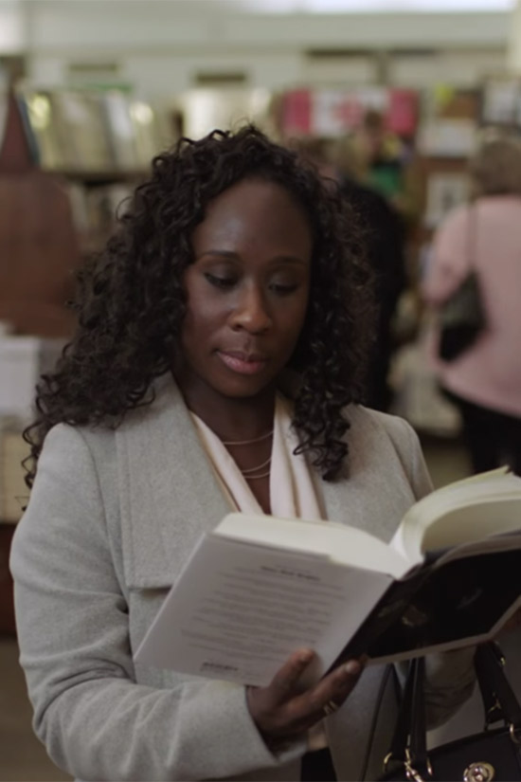
We’ve been making space on our bookshelves for Esi Edugyan’s writing since her debut novel, The Second Life of Samuel Tyne, was published in 2004. Born in Calgary to Ghanaian immigrant parents, Edugyan’s work explores diaspora, black histories, and ideas about belonging. In 2011, she won the Giller Prize for her second novel, Half-Blood Blues, which CBC included on their list of 150 books to read for Canada 150. Edugyan has also won the Ethel Wilson Fiction Prize and was shortlisted for the Man Booker Prize. Her most recent work, 2014’s Dreaming of Elsewhere: Observations on Home, was her first non-fiction book. She won the Giller Prize again in 2018 for her third novel, Washington Black.
Esi Edugyan

Slide 28
Marci Ien has long been a trusted name in Canadian broadcasting. The Ryerson alumna worked all over the country, joining CTV’s Atlantic bureau in Halifax in 1997. Since then, she’s covered Queen’s Park, national news, and was an anchor during the Vancouver Winter Olympics. Toronto-based Ien greeted Canadians every morning as the co-host of Canada AM for more than 13 years. She now graces our screens as one of the hosts on The Social. On top of her award-winning work, Ien also travels around the world for charity and is a mentor at an after-school program in Etobicoke.
Marci Ien

Slide 29
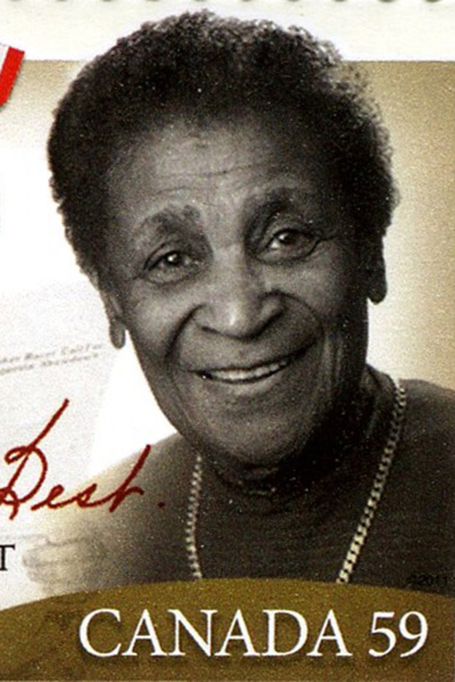
Carrie Best, an active civil rights advocate, is recognized as the first Black woman to publish and own a newspaper in Nova Scotia. She founded The Clarion in 1946, which circulated until 1956 when it was renamed The Negro Citizen. As a journalist and publisher, Best used her media platform to advocate for the rights of black Canadians and notably supported Viola Desmond’s case against the Roseland Theatre. (Best and her son had been arrested at Roseland a few years prior, also for sitting in the “whites-only” section.) Her work spread across several mediums including her own radio program, The Quiet Corner, and a column on human rights for the Pictou Advocate. She was awarded an honorary doctor of laws from St. Francis Xavier University and University of King’s College and, after her death in 2001, was posthumously awarded the Order of Nova Scotia in 2002.
Carrie Best

Slide 30
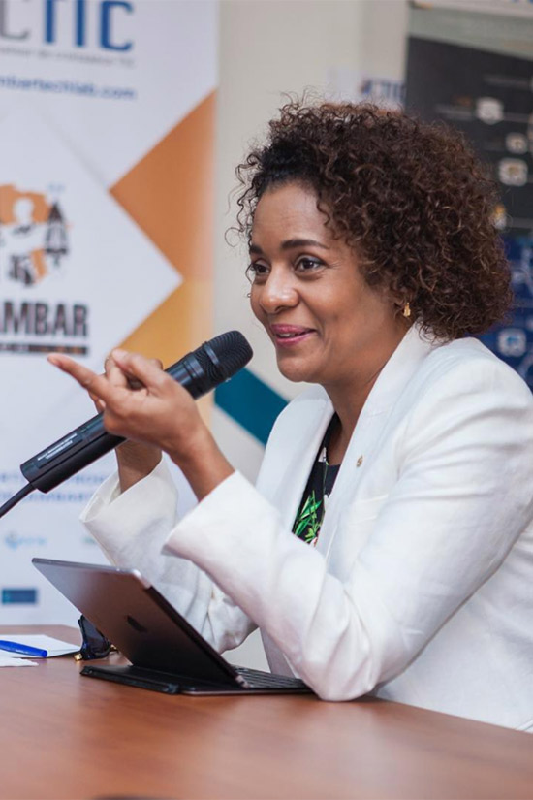
When she was just a young girl, Michaëlle Jean and her family fled their home in Port-au-Prince, Haiti to escape the totalitarian regime of François Duvalier. They settled in Quebec, where Jean eventually attended the Université de Montréal. While a student, she was also an advocate for survivors of domestic violence and worked at women’s shelters. In the late ‘80s, Jean became a journalist for Radio Canada, making her the first Black person in Canada to be seen on French TV news. By 2004, she was well-known by French Canadians and was hosting her own current affairs show. In 2005, Jean became Canada’s 27th Governor General of Canada; she was also the first Black person and third woman to fill the role. She was also the secretary general of the International Organisation of La Francophonie, becoming the first woman and Canadian to hold the post.
Michaëlle Jean

Slide 31
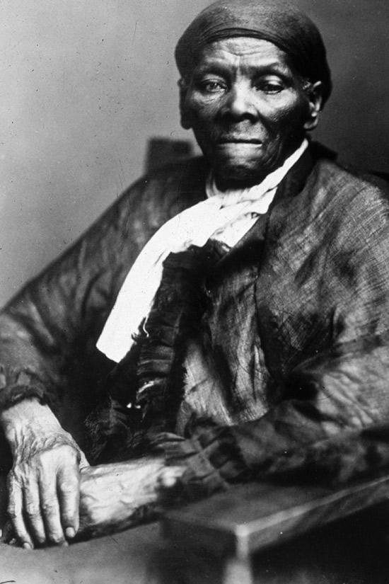
Harriet Tubman
You’re definitely familiar with American Harriet Tubman, one of the most well-known abolitionists from the U.S., but how much do you know about her connection to Canada? Tubman was born into enslavement in Maryland in 1820, finally escaping to Philadelphia in 1849 using the Underground Railroad. When she learned that her niece and her family were to be auctioned to another slaveholder, she returned to Maryland to help them flee, starting her work as a conductor on the railroad. After a law was passed that would allow refugee slaves who had fled to the North to be forced back into the slave trade, she took her rescue missions to St. Catharines, Ontario. Tubman moved to the Canadian city in 1851, where she would open her door to new refugees, all while continuing rescue missions. She made about 10 trips on the Underground Railroad, leading at least 70 people to safety in Canada.

Slide 32
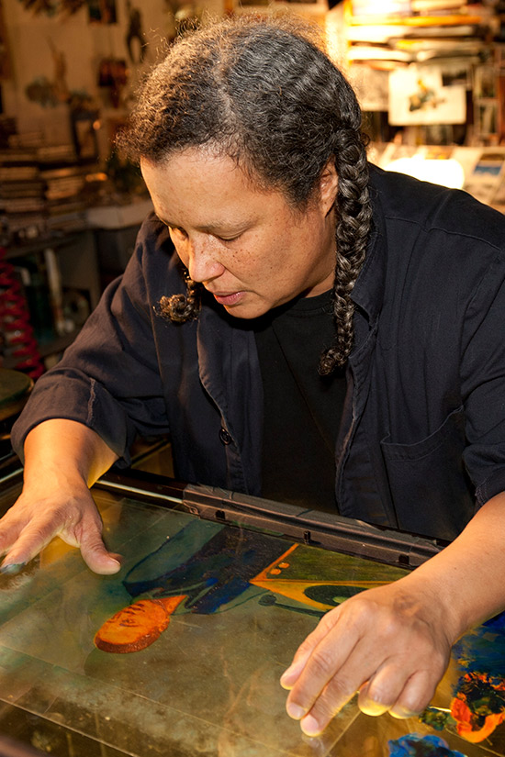
Montreal-born painter, illustrator, animator and director Martine Chartrand is truly a master of her craft. Four years after completing her BFA in visual arts at Concordia University and certificate in art education from the Université du Québec à Montréal, Chartrand directed her first animated film, T.V. Tango, for the National Film Board of Canada. Her second NFB film, Black Soul, won 23 awards, followed by her third, MacPherson, which won the Best Short Film Award and the Public Award for the Best Canadian Short Film at the Montreal World Film Festival 2012. Chartrand studied under famed paint-on-glass animator, Alexander Petrov, and helped with the preparation and production of his animated film The Old Man and the Sea. Today, Chartrand continues travel to around the world to hold lectures and workshops for paint-on-glass animation.
Martine Chartrand

Slide 33
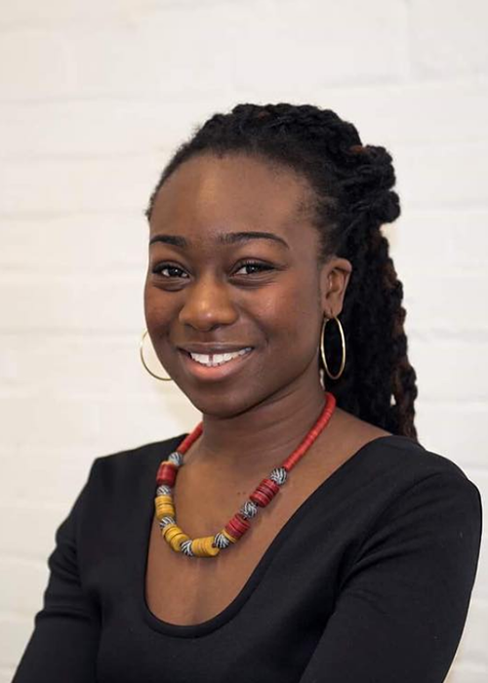
Eugenia Duodu
Eugenia Duodu is a Toronto-based academic, mentor and CEO of Visions of Science Network for Learning, a STEM-based organization that runs educational programs for low-income youth in the GTA. Her love of science and volunteer work came together after volunteering for Visions of Science at a science fair during the studies at University of Toronto. By the time she finished her PhD in Chemistry, Duodu went from being running the organization part-time, to handling all aspects of the organization full-time as CEO. As recently as 2017, Duodu spoke at the annual TEDxYouth Conference in Toronto about her pursuit of science as a black woman in STEM. She continues to work in Toronto with various community partners to engage and encourage youth to explore opportunities in STEM

Slide 34
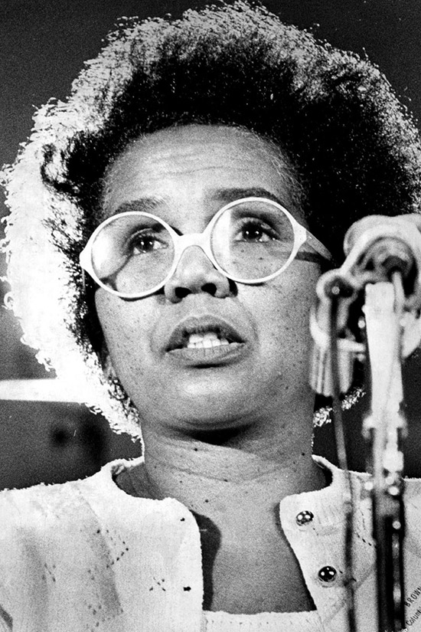
Rosemary Brown
Rosemary Brown was a Canadian social worker and politician. Born in Jamaica in 1930, Brown immigrated to Canada in 1951 to study at McGill University and later moved to British Columbia to earn her Masters of Social Work. After years of activism, she decided to join provincial politics. She won a B.C. seat for the NDPs in 1972, making her the first black woman to be elected to any provincial legislature in Canada. During her 14 years as a Member of the Legislative Assembly (MLA), she dedicated herself to a variety of issues, including eliminating sexism from B.C.’s educational material. Brown also became the first black woman to run for the leadership of a federal party; she came in second in the NDP’s 1975 leadership election, using the slogan “Brown is Beautiful” during her campaign. After leaving politics in 1988, she returned to advocacy and was eventually appointed Chief Commissioner of the Ontario Human Rights Commission five years later.

Slide 35
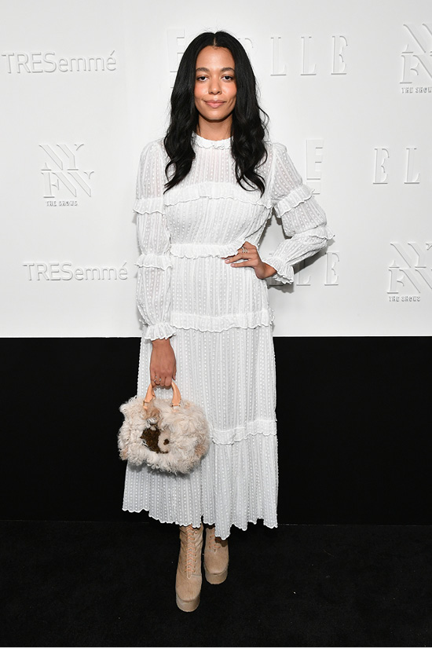
Aurora James
Aurora James is the cool Toronto girl we all want to become. Her eye for style began in childhood from travelling the world with her mother, whose closet was filled with a collection of traditional yet stylish pieces from just about everywhere. She attended classes at Ryerson University for Journalism but left before graduating. She worked with legendary Canadian fashion journalist, Jeanne Beker, at Fashion Television and later moved to L.A. to work as a freelance creative consultant. It wasn’t until a trip to Morocco in 2011 that James started exploring the world of design. Inspired by the local shoemakers she met and later collaborated with, James founded Brother Vellies in 2013 as an environmentally sustainable footwear brand. Her work quickly gained popularity, most notably for her collection of ‘vellies’ or desert boots, and James expanded her business to work with artisans in Kenya and Morocco. James is currently based in Brooklyn but visits Africa every couple of months to continue working with craftspeople in South Africa, Kenya, Nigeria, and Morocco.

Slide 36
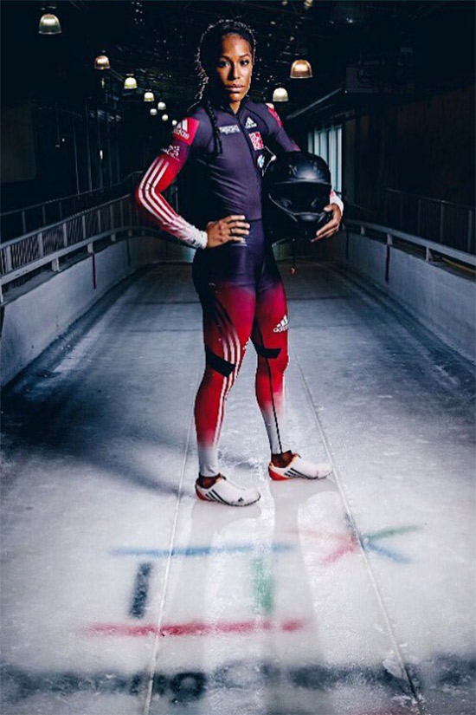
Phylicia George
As an Olympian, Phylicia George has represented Canada all over the world. The Scarborough-born athlete first started running hurdles when she was 15 years old after falling in love with running and competing while racing her dad in parking lots. She first represented Canadians on an international stage at the 2012 Olympics in London, where she finished sixth in the hurdles event and achieved a personal best time. Although she had to battle through injuries, George continued to compete, appearing at both the Pan Am Games in Toronto and the 2016 Rio Olympics. But an Olympic medal eluded her—until PyeongChang. In 2018, George became the first Black Canadian woman to compete in both the summer and winter games when she teamed up with champion bobsledder Kaillie Humphries. The duo won bronze at the women’s bobsleigh final at the 2018 Winter Olympics – Canada’s (and Humphries’) third consecutive Olympic medal at the event.

Slide 37
We go way back with Grace Mahary: she won the ELLE Canada/Québec model search in 2005. The Eritrean-Canadian model was born in Edmonton, Alberta and moved to Toronto on her own when she was just 16 years old to pursue modelling. After winning the contest, she began to model locally. By 2011 she moved to Paris hoping to start modelling internationally. It paid off: the next year Mahary made her big catwalk debut at Givenchy’s fall show. From there, she appeared in a number of shows, including Chanel, Christian Dior, and Valentino; in 2014 she was the only Canadian model to walk the Victoria’s Secret Fashion Show. When she isn’t modelling, New York-based Mahary is dedicated to philanthropy. In 2015 she founded Project Tsehigh, a non-profit that aims to provide sustainable and renewable energy to impoverished communities.
Grace Mahary

Slide 38
We’ve had Edmonton-born singer Ruth B’s (full name Ruth Berhe) voice stuck in our head for years. The 22-year-old got her start on Vine, where she would regular post snippets of her covering songs. In 2014, she shared six seconds of chords and vocals she wrote inspired by the TV show Once Upon a Time that quickly reached 84,000 views—a lot for her at the time. The reaction inspired the singer/songwriter to complete the song that went on to become her hit “Lost Boy.” The song grew more and more popular online and by 2015 the Canadian had been signed to a record label. By 2017, she was a superstar on the Canadian music scene, winning Breakthrough Artist of the Year at the Juno Awards.
Ruth B

Slide 39
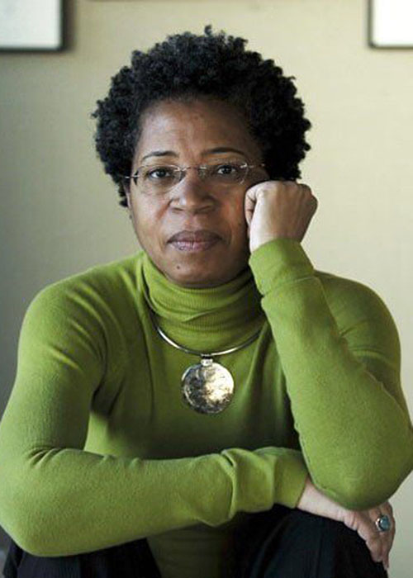
Dionne Brand
Brand’s contributions to Canadian literature span decades and genres. Best known as a poet, Brand has also written short stories, essays and several non-fiction books often addressing the intersections of race and gender in Canada. Before she moved to Toronto from Trinidad, Brand submitted poems to various newspapers under the pseudonym Xavier Simone—a nod to legendary singer Nina Simone. In 1970, Brand attended the University of Toronto and graduated with a BA in English and Philosophy and MA in the Philosophy of Education. In 1997, she won the Governor General’s Award for Poetry and Trillium Book Award for her book of poetry, Land to Light On. In 2009, she was named Toronto’s third poet laureate and in 2017 was appointed to the Order of Canada.

Slide 40
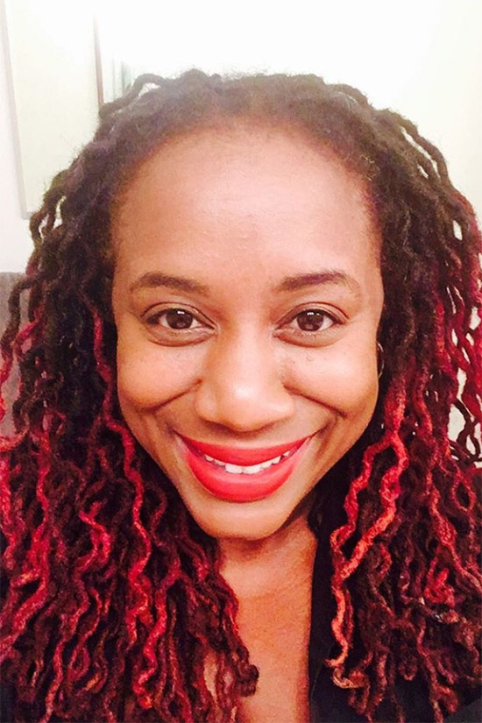
As an award winning playwright, actor, and stand‐up comedian, Trey Anthony has entertained Canadian audiences for almost two decades. She is best known for her first play, ’da Kink in my Hair, which debuted at the Toronto Fringe Festival in 2001. The play won four NAACP Theatre Awards and was later adapted for television. The series aired on Global TV from 2007 to 2009, making Anthony the first black Canadian woman to write and produce a television show for a primetime network in Canada. (Anthony was born in London, but moved to Canada with her mother when she was 12.) In 2010, she spoke at the second annual TEDxToronto conference about her experiences as a queer black woman in the entertainment industry and encouraged others to pursue their dreams. Today, Anthony continues her work as a speaker, writer and mentor.
Trey Anthony

Slide 41
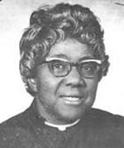
Rev. Addie Aylestock
(1909 - 1998)
First ordained Black female Church minister in Canada.

Slide 42
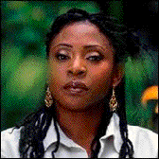
Dr. Afua Cooper
(born 1957)
Jamaican-born Canadian historian, author and dub poet

Slide 43
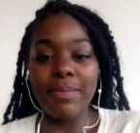
Dr. Alexandra Bastiany
Canada's first Black female Intervention Cardiologist

Slide 44
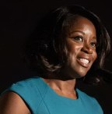
Andrea Bain
CTV News Anchor author, podcaster and on-air personality.

Slide 45
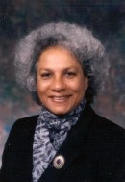
Anne Cools
(born 1943)
Retired Senator. First Black person appointed to Canada's Upper House

Slide 46
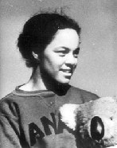
Barbara Howard
(1920 - 2017)
Sprinter, believed to be the first Black Canadian athlete to represent Canada in an international competition.

Slide 47
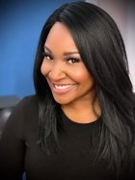
Catherine Verdon-Diamond
CBC weather host and temporary host of CBC's
"Our Montreal"

Slide 48
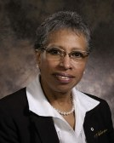
Dr. Daurene Lewis
(1943 - 2013)
First Black female Mayor in Canada

Slide 49
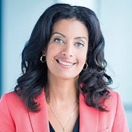
Dominique Anglade
(born 1974)
First black woman to lead a provincial party in Quebec. Leader of Quebec's Liberal Party, the Official Opposition of Quebec. She has served as a Member of the National Assembly of Quebec.

Slide 50
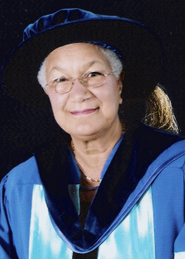
Dr. Dorothy Wills
(born 1933)
Canada's first Black female faculty Dean

Slide 51
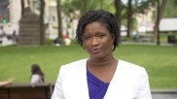
Elysia Bryan-Baynes
Quebec’s first full-time Black female anchor
(on Global News for 17 years), now retired.

Slide 52
Our feelings are sent by our brain.
To change the way we feel, we must change the way we think.
*Personal Experiences *Family *Friends/Peers *Important Adults *Media *Books

