Slide 1
Getting Ready for 2020-2021
February 3, 2020

Slide 2
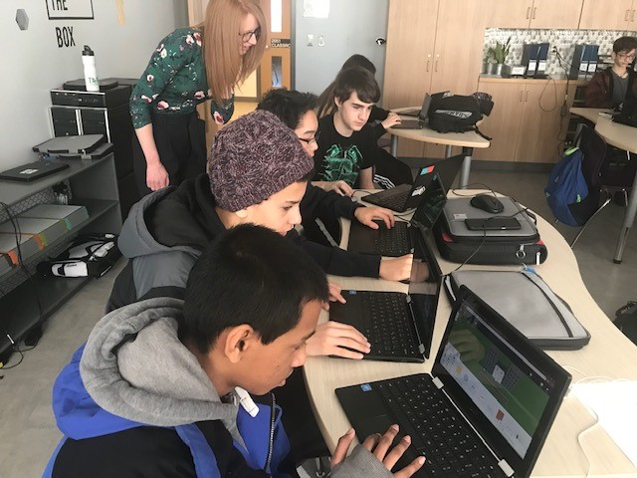
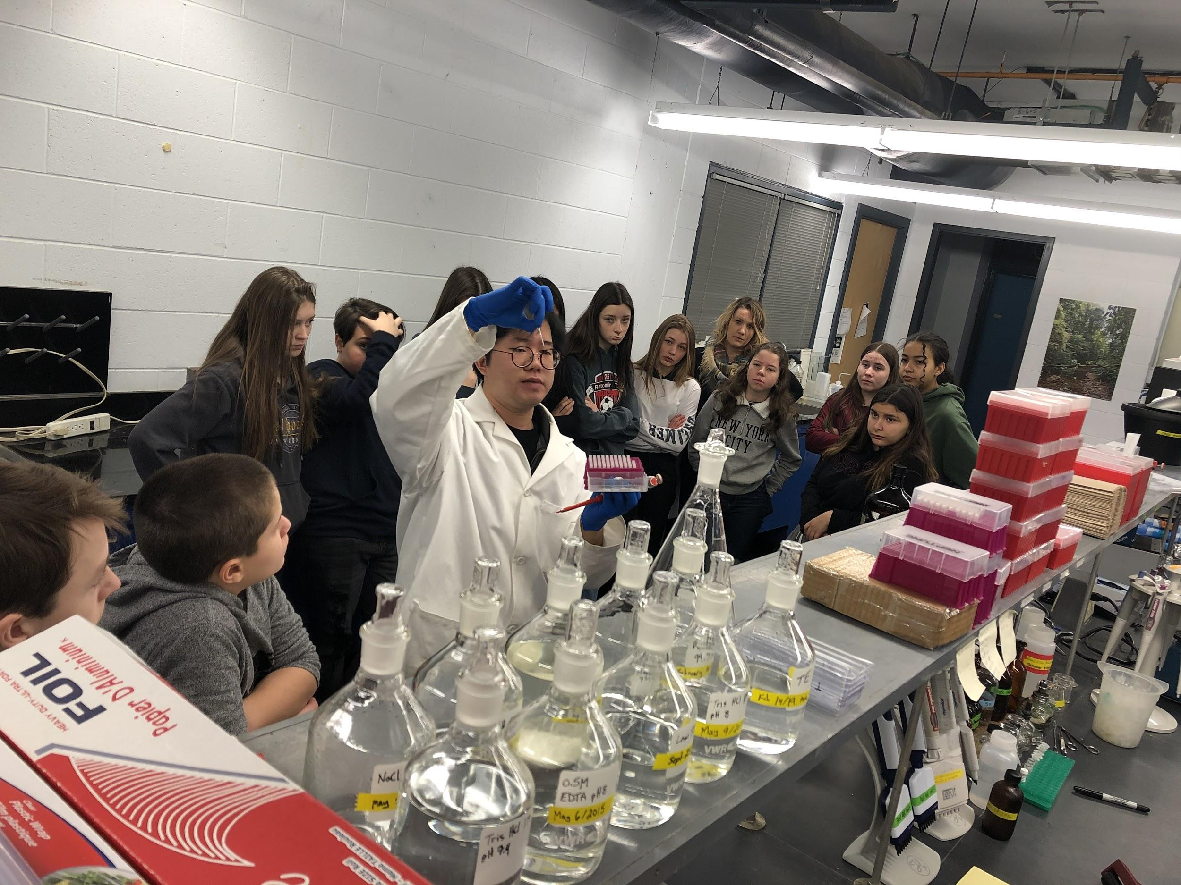
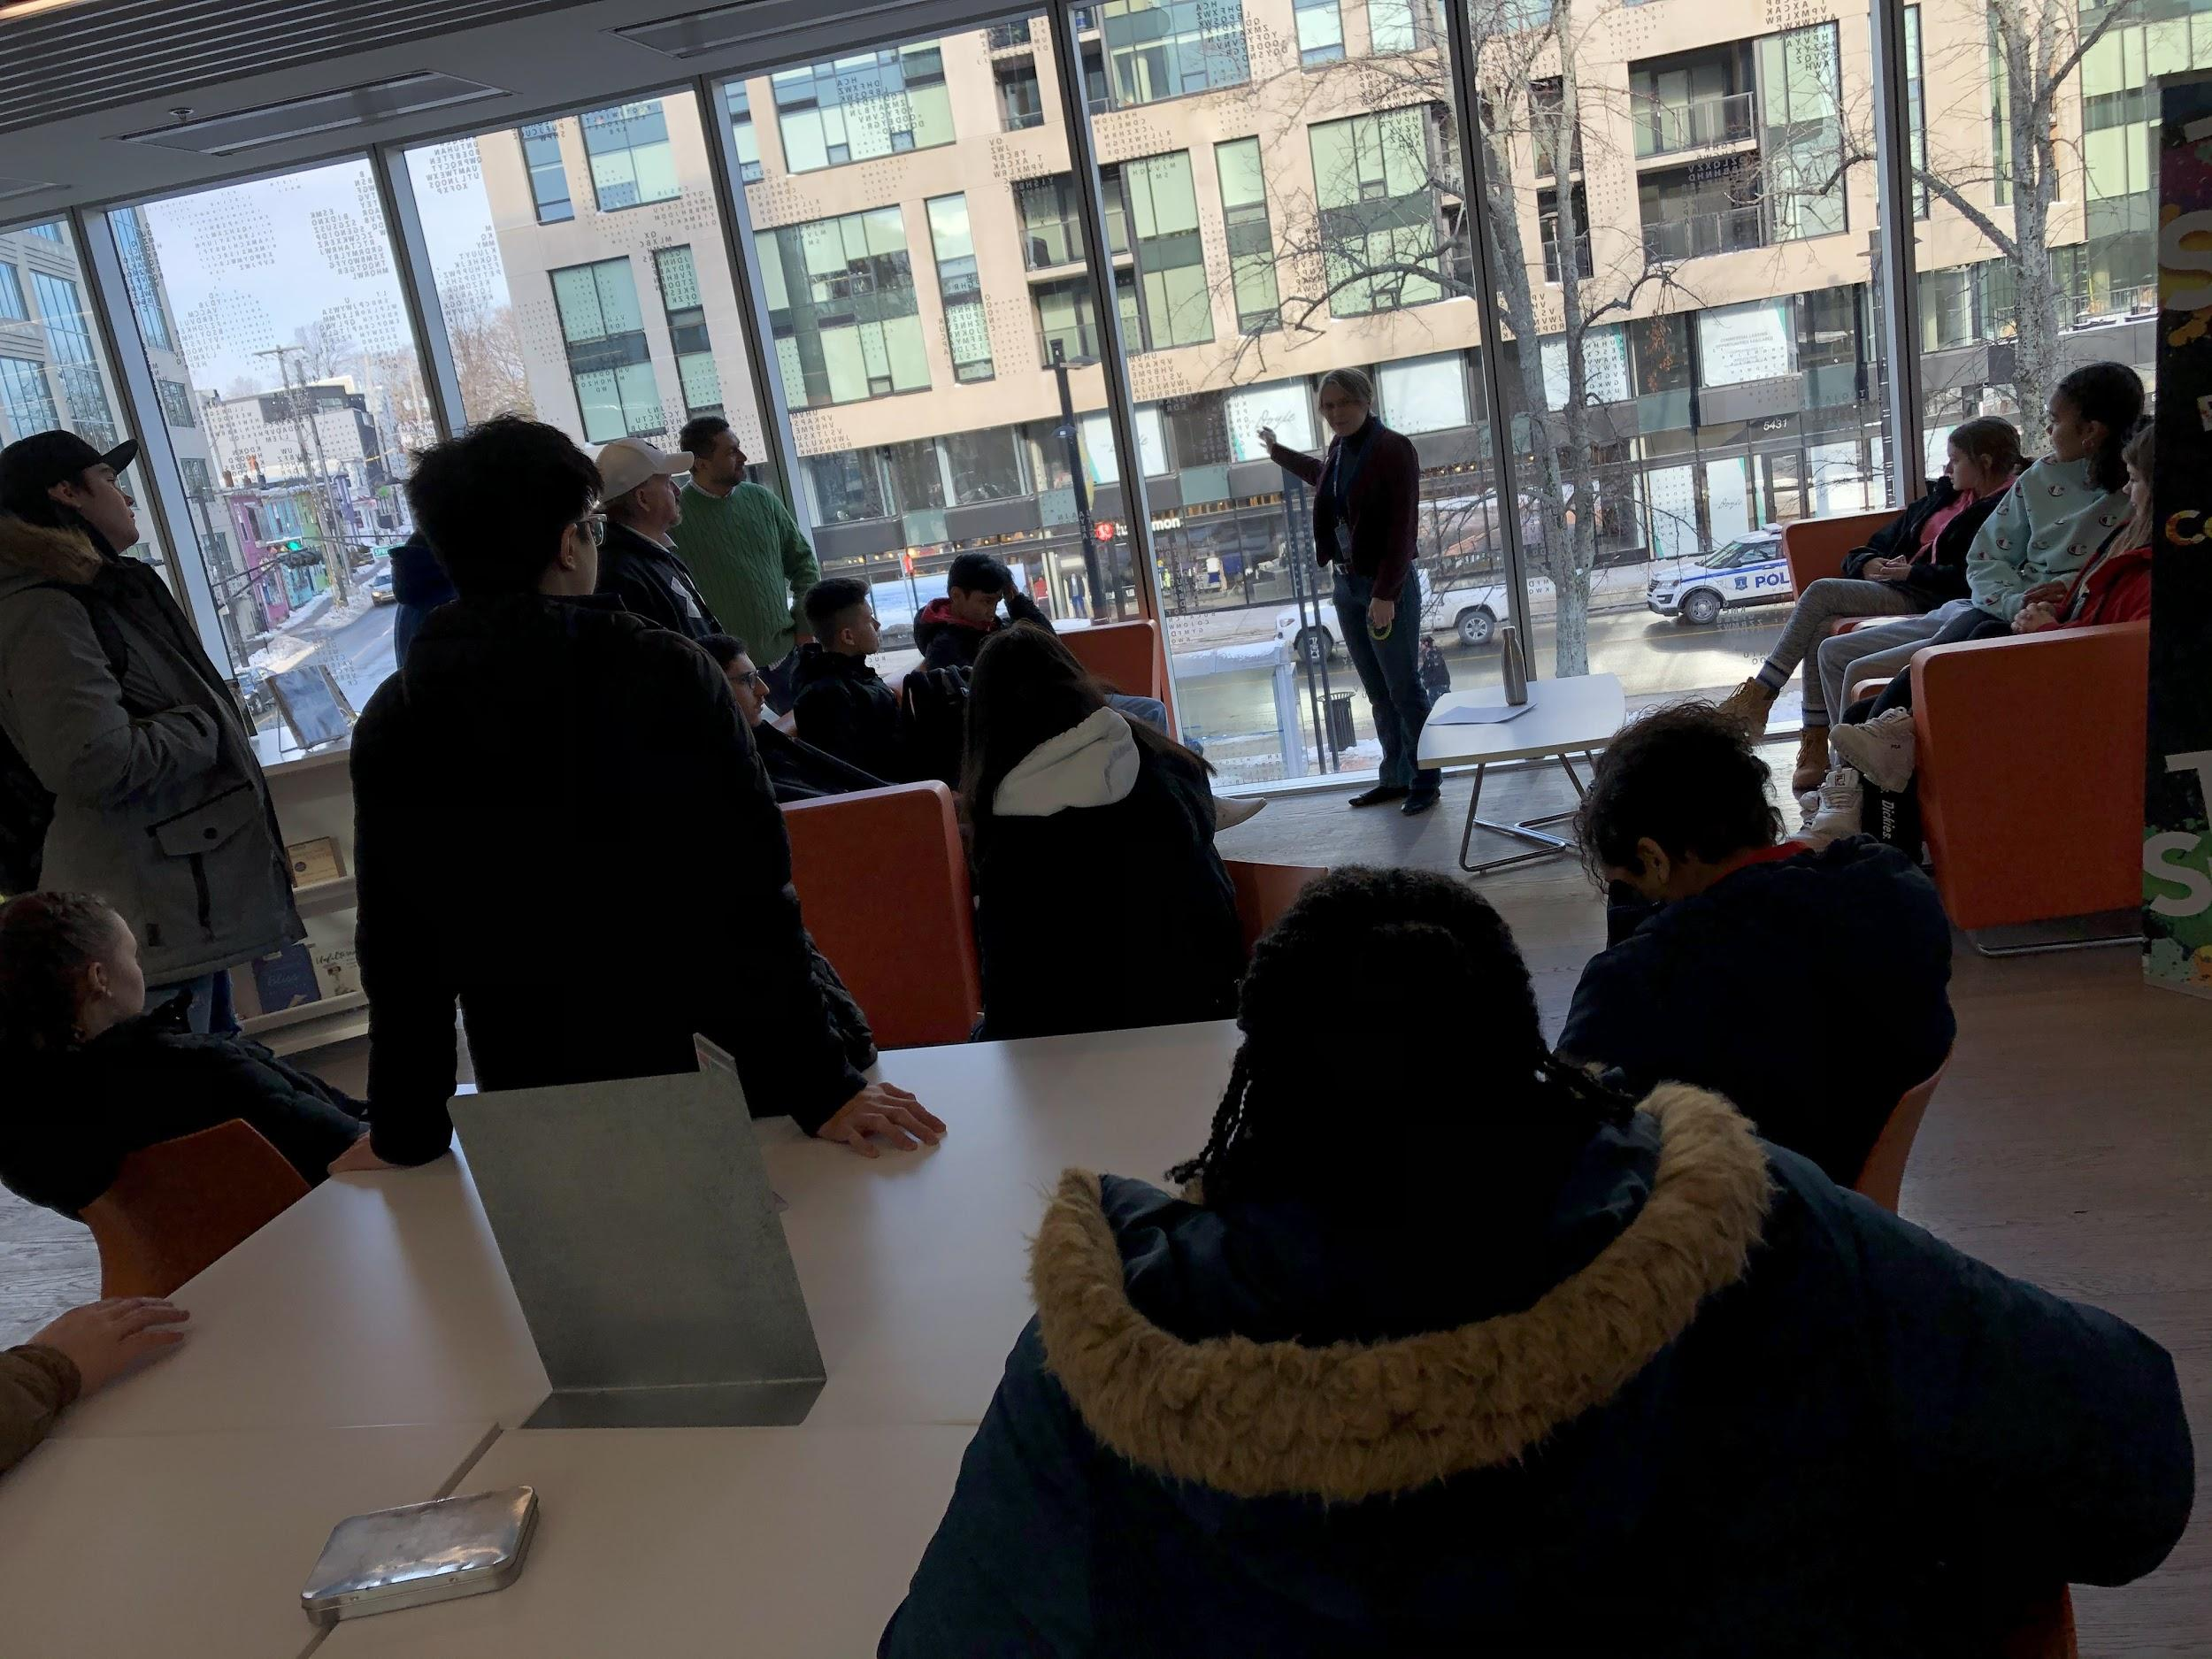
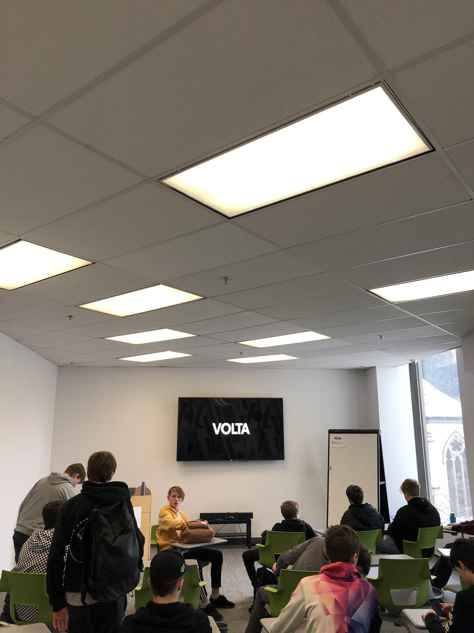
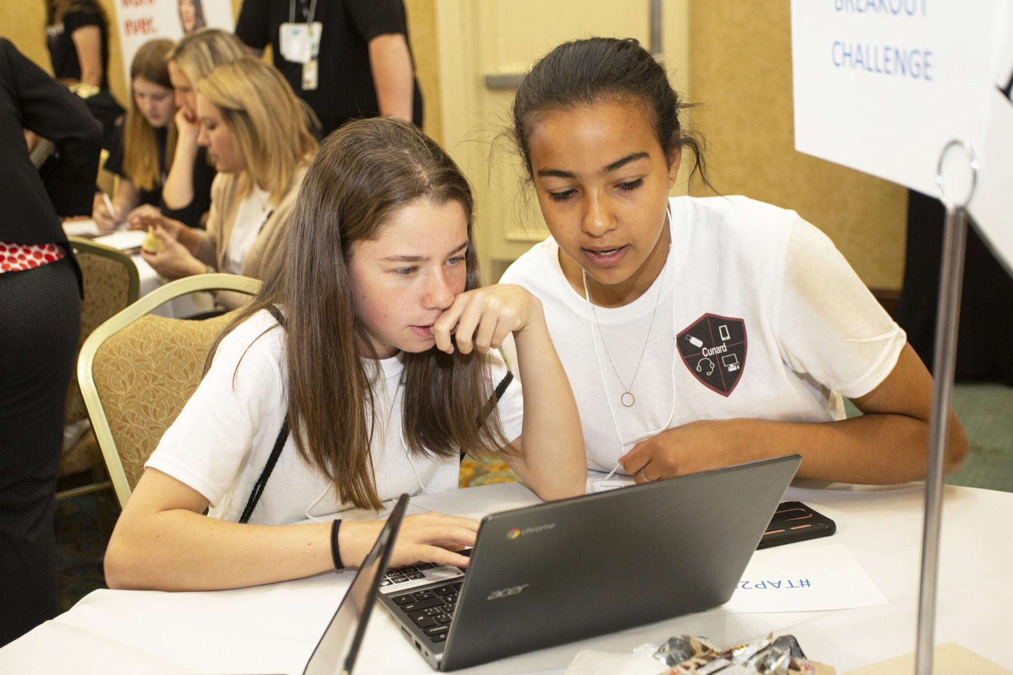
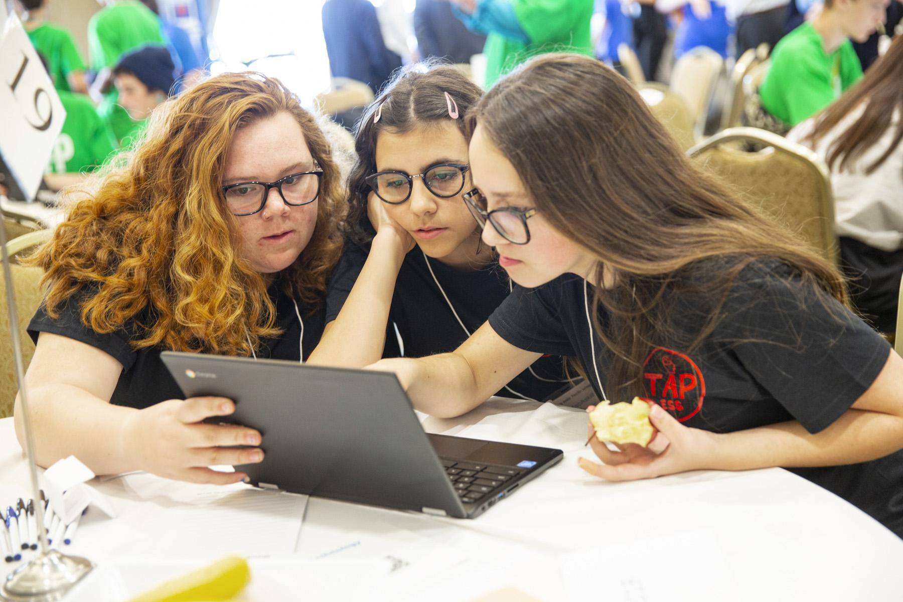
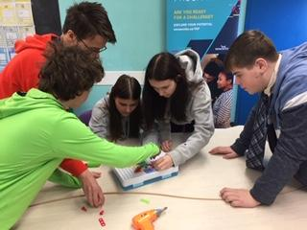
An Amazing Fall for TAP 9 Students
Students in the TAP Pilot have had such a busy fall - exploring IT careers, learning about and trying new technologies, developing new skills and applying new knowledge and skills to their classroom learning

Slide 3
Teachers
Partners
Many Partners - all Focused on Student Learning and Success
Student
EECD
Regions

Slide 4
Setting students up for SUCCESS
What did this look like?
Established learning environments that support integrated learning and IT exploration
Providing students with opportunities to explore IT skills and careers
Connecting students with IT partners for that real world perspective
Applying developed skills to learning
Investigating course and program options at high school and postsecondary
What will help me achieve my goals? Is IT the path for me? What else can I consider?

Slide 5
New curriculum developed for TAP students
Start
of
Dual
Credits
Grade 10 Curriculum
Existing curriculum reviewed; strategies for IT learning embedded

Slide 6
What to Expect in Grade 10
The majority of courses will be cohorted
Grade 10 courses will be selected for you
Career exploration continues
High level of commitment
during the summer between Grade 10 & 11, students are expected to engage in workshops/ learning opportunities with NSCC and IT partners to fulfill program requirements for high school and college (this will also happen between Grades 11 & 12)

Slide 7
Grade 10 TAP Students - Required Courses
English 10 Math 10 Career Development 10 Canadian Studies 11 Exploring Technology 11 Phys Education or Arts credit | Global Environment 10 (this course will result in a ½ credit in science and a ½ credit of global studies - 55 hours) Physical Science 10 (this course will result in a ½ credit in science - 55 hours)

Slide 8
Looking Ahead to the Coming Months
Career and skill exploration will continue to be a strong focus during the second half of the year
Students need to take advantage of all options offered to them to determine with their families where they see themselves in Grade 10 (students - ask lots of questions)
Is TAP the right fit for them? What else could be there in your future?
Students will be asked to engage in an expression of interest and interview process for Grade 10
there are more students than spaces available (described during initial presentations when pilot was introduced)
Decisions will be finalized by early June

Slide 9
Where to go for Info
Project Leads
Grade 9 Teacher
School Principal/ Guidance Counsellor

